Slide 2
Fuel Cell Systems
    Efficient and sustainable distributed energy production

Slide 3
Transformational trends
Drivers
Electrification
Need to reduce CO₂
Accelerators
New technologies
Regulatory framework
Unmet needs
Active end-users
Notes:
Electrification - urbanisation, new economies, new industries, new consumption modes
- by 2035, energy + 41%, gas + 55% and electricity +180%
Reduct. CO2 - as time goes by, need becomes ever more pressing but also
willingness to bear the burden increases
Unmet needs - disconnect between economic growth and energy consumption in mature economies – quality rather than quantity
- limitations in generation or network capacity or their extension
- integration of intermittent & distributed generation
New tech - convergence of IT + energy + market mechanisms,
- energy storage
- And not least: new conversion technologies
Regulation - responds to the above changes in needs and agenda
Active user - facilitated by technological means + regulatory freedoms
- own standards of consumers for for example emissions or reliability

Slide 4
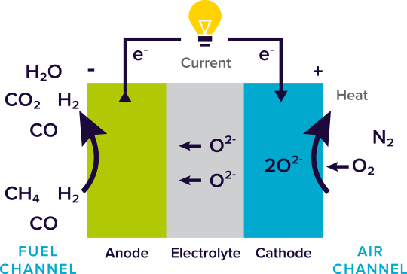
What is a fuel cell ?
  Fuel cell is an electrochemical device that converts chemical energy of fuel directly into electricity and heat.
  Key properties:
  High electrical efficiency
  Low emissions
  High reliability, no moving parts
  DC power output
  Scalable from mW to MW
Tuomas Hakala Public

Slide 5
The most common fuel cell types
FC Type | Anode Fuel | Cathode oxidant | Operating temp (°C) | Efficiency (LHV) | Application
PEM | H₂ | Air | 60 – 100 | 30 – 40 | Portable Small residential Transportation
AFC | H₂ | O₂ | 60 – 120 | 30 – 40 | Portable Small residential Transportation
PAFC | H₂ | Air | 150 – 250 | 35 – 45 50 – 70 * | Med. Residential Commercial
MCFC | H₂, CO, NH₃, CH₄ | Air+CO₂ | 550 – 700 | 45 – 55 80 – 90 | Industrial Commercial Large residential
SOFC | H₂, CO, NH₃, CH₄ | Air | 650 – 850 | 45 – 55 80 – 90 * | Industrial Commercial Large residential
Low
temperature
Intermediate
temperature
High
temperature
Tuomas Hakala Public

Slide 6
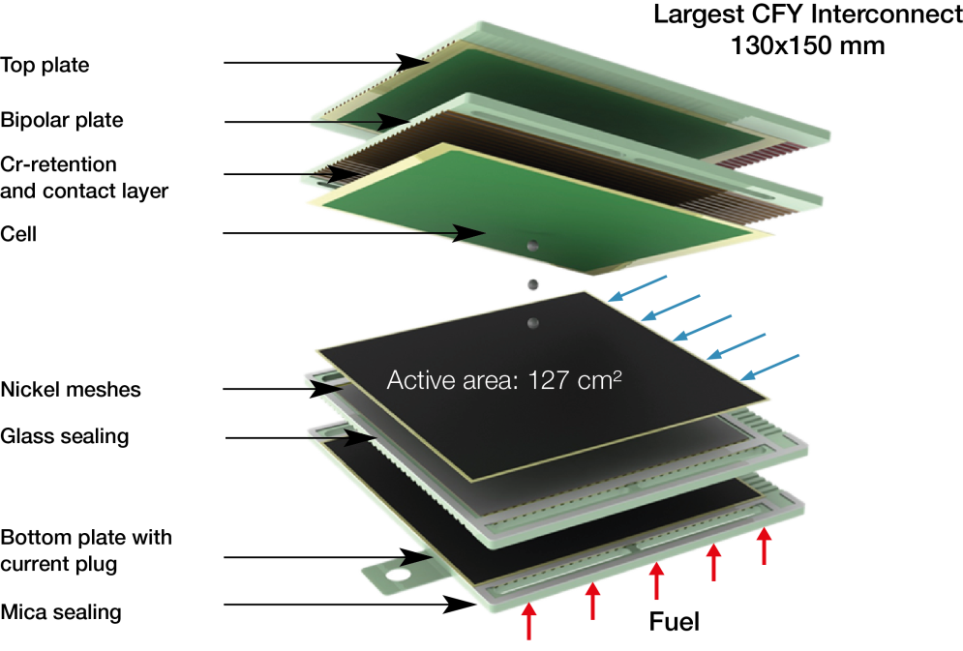
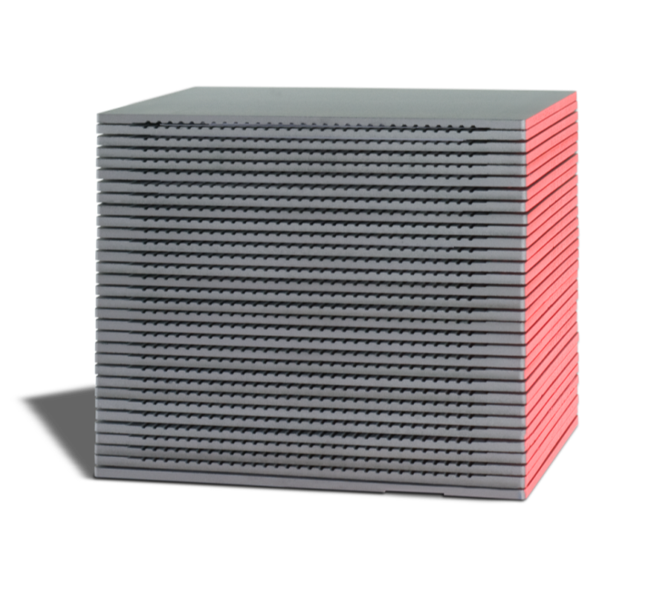
SOFC Cell and Stack
Operating temperature 650 – 850 °C
A single fuel cell produces approximately 0.7…0.9 V
Cells are connected electrically in series.
  1 kW stack consist 30 cells
Picture source : Fraunhofer IKTS
Picture source : Plansee SE

Slide 7
Fuel Cell Efficiency and Power Range
Source : W. Vielstich, Handbook of Fuel cells – Fundamentals Technology and Applications,
Volume 1, Chapter 4, p. 29. Wiley (2004), ISBN: 0-471-49926-9

Slide 8


More with less
  SOFC makes advantage of scale a thing of the past.
2%
Transmission
and distribution
Power 53%
Heat 32%
Power 44%
Heat 38%
SOFC-CHP (kW-scale)
GT CHP (MW-scale)
3%
13%
15%
Heat
distribution
Process
losses
Process
losses
Notes:
SOFC makes local base load generation possible at small scale – beats centralized generation in conversion efficiency and by omission of distribution losses
High temperature fuel cells are ideal for combined heat and power generation due to clean, hot exhaust gases (No sulfur compounds)

Slide 9
Power plants anywhere
  Fuel cell systems emit no NOx, SOx, HC or particulate emissions
  Noise level < 70dB, no vibrations
  Low maintenance, simple interfaces – only fuel and power connections and clean, hot exhaust available for heat recovery.
  Freedom of placement outdoors or indoors.

Slide 10
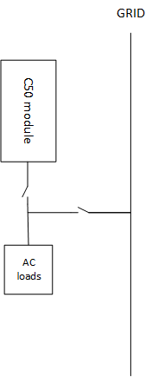
Grid-tied or stand-alone
  Power availability improved by a factor of >20.
  Modular structure facilitates desired level of redundancy.

Slide 11
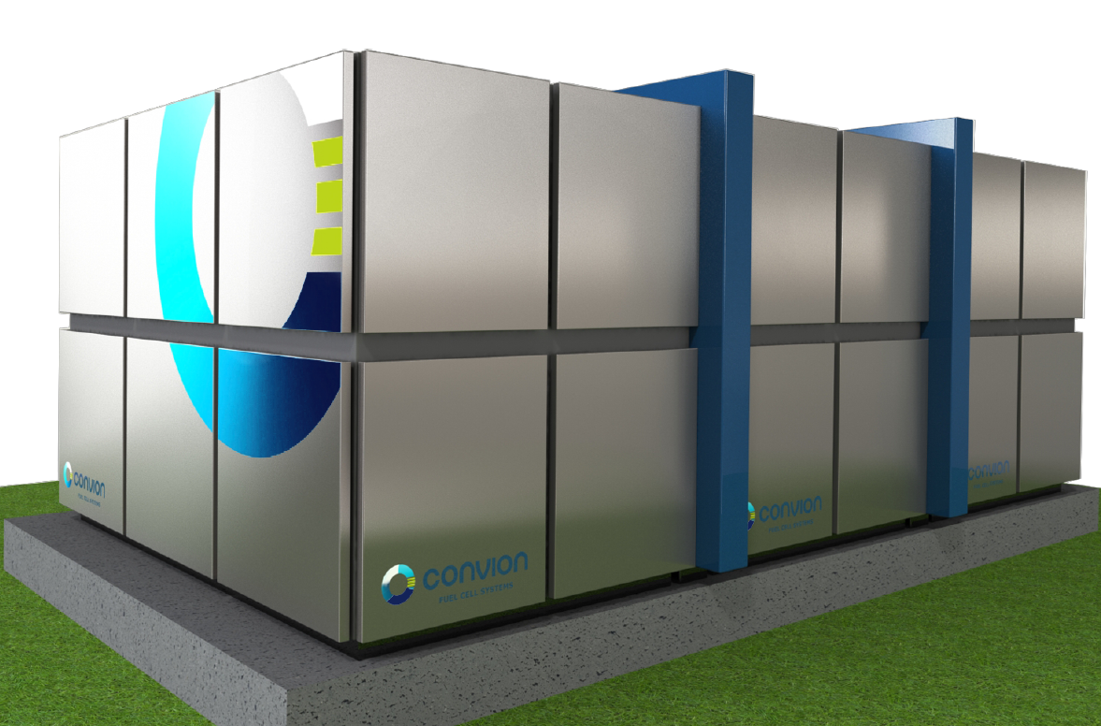
Convion Solution
  On-site power and heat generation
  Electrical efficiency 53 – 65%
  Total efficiency up to 85%
  High availability, capable of island mode operation
  Scalability, 50 kW and beyond
  Zero NO_{x}, SO_{x} and particulate emissions
  Natural gas, Biogas and gas mixtures
C50, 50kW fuel cell power unit
3xC50, 150kW fuel cell power unit
© CONVION November 14, 2018
Tuomas Hakala Public

Slide 12
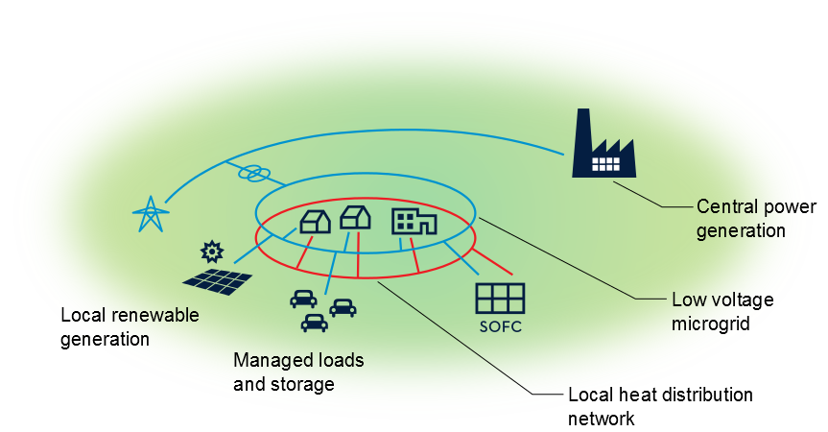
Integrated CHP generation
– an enabler for smart micro grids
Tuomas Hakala Public
Notes:
A cluster of loads, micro sources and/or storage operating as a single controllable system that provides power and possibly also heat to its local area.
Parallel to grid: fuel cell operates in base load mode but
in case of grid failure
able to island mode and load following under management of microgrid ctrl
Local low voltage or sometimes even DC voltage solution
Aggregation of loads, storage and generation capacity enables active participation in grid mgt → cost optimization and stabilization

Slide 13
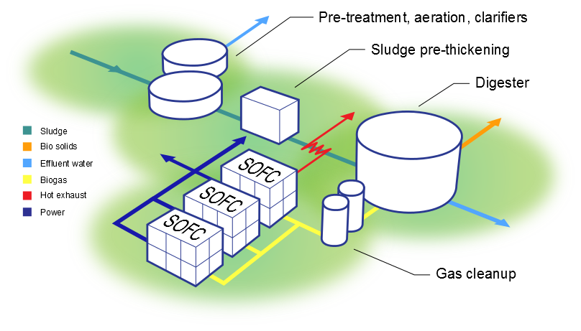
Fuel flexible by nature
– resource efficient communities
WWTP, 3*C50 SOFC
Tuomas Hakala Public
Notes:
Anaerobic digestion of organic matter to biogas and utilization of exhaust heat in digestion process is a special case of local integration, this time around a local fuel source.
Provides a way to significantly reduce emissions related to treatment of organic waste or side streams → it is foreseeable that e.g. waste water treatment turns from a significant municipal energy consumer to a net producer.
Convion will demonstrate such an application in 2016.

Slide 14
Biogas and SOFC CHP – an opportunity
  Distributed power generation provides a way to utilize organic waste and low energy value feed stocks locally with tolerable logistic cost.
  Efficient, lossless utilization of a biogas resource by a local CHP can cut overall emissions significantly and ensure undisrupted plant operation.
  By their modular nature, Convion C50 SOFC systems provide easy expandability, minimum maintenance and long up-time.

Slide 15
Conclusion
  Fuel cells are building blocks of smart micro grids.
  CHP and island mode capability of Convion products provide an end user solution that can serve several customer groups, market segments and applications.
  Convion product is adaptable to biogas and natural gas operation.
  Modular approach makes possible power ranges from 50 to several hundreds of kilowatts.
© CONVION November 14, 2018
Tuomas Hakala Public

